Slide 1

Adventure Works BI End-To-End
Presented by : Alhosein Aly

Slide 2

What is adventure works ?
Adventure Works Cycles is a multinational company for bikes manufacturing, the company continues to grow. They demand an End-To-End Business Intelligence Solution to track and analyze their sales for a better decision-making.

Slide 3
Project Phases: Data integration
3. Data Loading
Phase: Load
Tool: SQL Server
Steps:
Defined the destination (data warehousing) database schema in SQL Server.
Configured data destination tasks in SSIS to load the transformed data into the data warehousing database.
Executed the SSIS package to load the data.
Verified the data load by querying the data warehousing database and checking for correctness.
2. Data Transformation
Phase: Transform
Tool: SSIS (SQL Server Integration Services) in Visual Studio
Steps:
Created an SSIS project in Visual Studio.
Designed data flow tasks to define the transformation process.
Added data sources to import the extracted data.
Implemented various transformation tasks such as:
Data conversion (changing data types, formatting).
Applying business rules.
Validated and tested the transformations to ensure accuracy.
1. Data Extraction
Phase: Extract
Tool: SQL Server
Steps:
Connected to the staging database in SQL Server.
Identified and selected the necessary data tables and fields for the project.
Wrote and executed SQL queries to extract the data.

Slide 4

Project Phases :Data Analysis and Visualization Part
Data Analysis
Phase: Analyze
Tool: Power BI
Steps:
Connected Power BI to the data warehousing database.
Imported the necessary tables and fields into Power BI.
Created data models and relationships between the tables.
Designed and built various reports and dashboards to visualize the data.
Applied filters, slicers, and drill-downs to enhance the analysis.

Slide 5

Data integration
In this section, we delve into the Data Integration aspect of our project, which was accomplished using SQL Server Integration Services (SSIS). This phase is critical as it involves the transformation of raw data into meaningful information that can be loaded into the data warehousing system for subsequent analysis.
The following slides will provide a visual walkthrough of the SSIS package used for data integration. We have included screenshots of the Control Flow, two Dimension tables, and the Fact table. These screenshots will not only illustrate the structure of the SSIS package but also, where possible, demonstrate the flow of data in real-time, showing the number of records processed at each stage.

Slide 6

Control flow
Truncate table
Populate Customer
This task truncates (empties) the existing data in the target tables to ensure that fresh data can be loaded without duplications or conflicts. Truncating tables is a common step to prepare for a new data load.
This task loads data into the Customer dimension table .Similar to the Product table, it extracts, transforms, and loads customer-related data.
Populate Fact_Sales
Populate Product
This task loads data into the Product dimension table. It involves extracting product-related data from a source system, transforming it as needed, and then loading it into the data warehousing database.
This task loads data into the Fact table, specifically fact_sales. The Fact table typically contains transactional data and metrics that reference the dimension tables. It aggregates data from various sources, including product and customer information, to provide comprehensive insights.

Slide 7
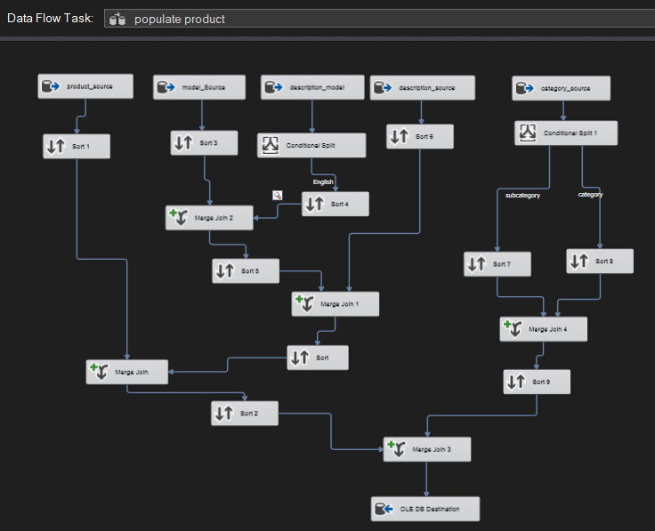
Data Flow Task - Populate Product
The process involves extracting data from various sources, sorting and conditionally splitting the data, merging it to create a unified dataset, and finally loading the integrated data into the target database.
The "populate product" task ensures a seamless integration of product-related data, combining multiple data sources into a single, cohesive dataset. This process guarantees that the data is accurately transformed and ready for further analysis, contributing to the overall efficiency and reliability of our data warehousing system.

Slide 8
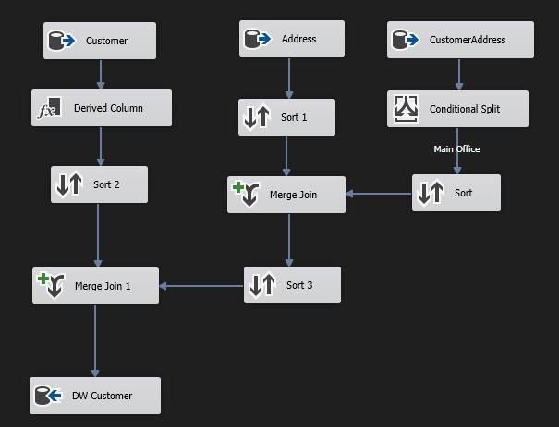
Data Flow Task - Populate Customer
The process involves extracting data from customer, address, and customer address sources, performing sorting, conditional splitting, and merging operations, and finally loading the integrated data into the target data warehouse. The "populate customer" task ensures the accurate and efficient integration of customer-related data from various sources. By transforming and merging this data, it creates a unified dataset that is loaded into the data warehouse, providing a solid foundation for customer data analysis and reporting.

Slide 9
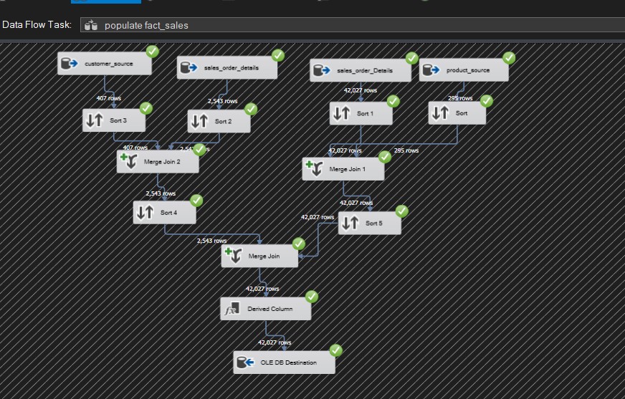
Data Flow Task - Populate Fact_Sales
The process involves extracting data from customer, sales order, and product sources, sorting and merging the data, and finally loading the integrated data into the target database.
The "populate fact_sales" task ensures a comprehensive integration of sales-related data, combining multiple data sources into a unified dataset. This process guarantees that the data is accurately transformed and loaded into the data warehousing system, providing a robust foundation for detailed sales analysis.

Slide 10

Data Analysis and Visualization Part
After completing the data integration and transformation processes using SSIS, the next crucial step was to load the cleansed and structured data into Power BI for detailed analysis and reporting. Power BI is a powerful tool that enables us to create data models, perform in-depth analyses, and visualize data through interactive dashboards and reports.

Slide 11
Data Analysis and Visualization Part
In this phase, we focused on:
Data Modeling:
Established relationships between different tables to create a coherent data model.
Defined calculated columns and measures to support advanced analytics.
Ensured data integrity and consistency across the model.
Data Analysis and Visualization:
Designed and built various reports and dashboards to visualize key metrics and insights.
Applied filters, slicers, and drill-downs to enhance data interactivity and user experience.
Leveraged Power BI’s advanced features to uncover trends, patterns, and actionable insights.
Data Loading:
Connected Power BI to the data warehousing database where the transformed data was stored.
Imported the necessary tables and fields into Power BI.
This comprehensive approach not only facilitated effective data analysis but also empowered stakeholders with the ability to make data-driven decisions based on robust, real-time insights. The integration of SSIS for data processing and Power BI for analysis and visualization created a seamless end-to-end data solution.

Slide 12
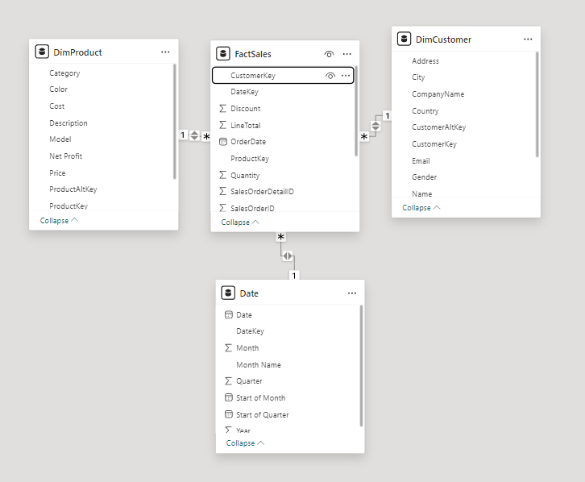
Data Model in Power BI
The relationships in this Power BI model effectively link customer, product, and date dimensions to the central fact table (FactSales). This structure allows for comprehensive sales analysis. You can explore sales trends based on various factors like specific customers, product categories, and date ranges. By combining these dimensions with the sales data, you can gain valuable insights into customer behavior, product performance, and overall sales effectiveness
Here's a breakdown of these connections:
Customer and Product Details: The DimCustomer and DimProduct tables provide rich context for our sales data. They hold details like customer information and product attributes.
The Heart of Sales: The FactSales table is likely the central point, storing individual sales transactions.
Connecting the Dots: Relationships link these tables. For example, a single customer can have many sales transactions (one-to-many). Similarly, a product can be involved in numerous sales. Dates likely connect to both customers and sales with many-to-one relationships, associating a date with multiple customers and transactions.

Slide 13
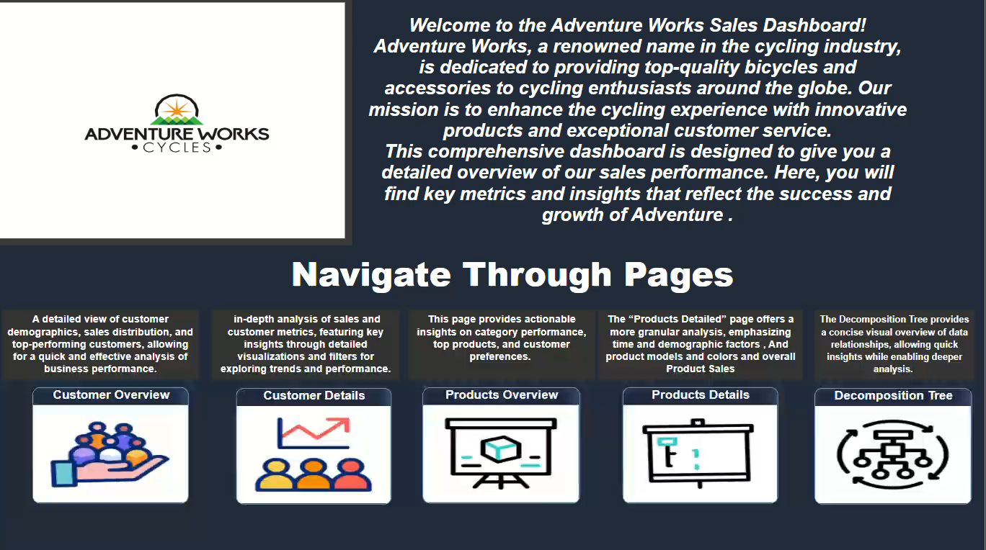
• Power BI Screenshots from each page of the report: welcome Page
Following a brief company introduction, the welcome page serves as a navigation hub, guiding you to report pages that cater to your business interests. Explore customer (overview and details), product (overview and details), and the decomposition tree—an analytics adventure awaits, revealing KPIs and essential business insights.

Slide 14
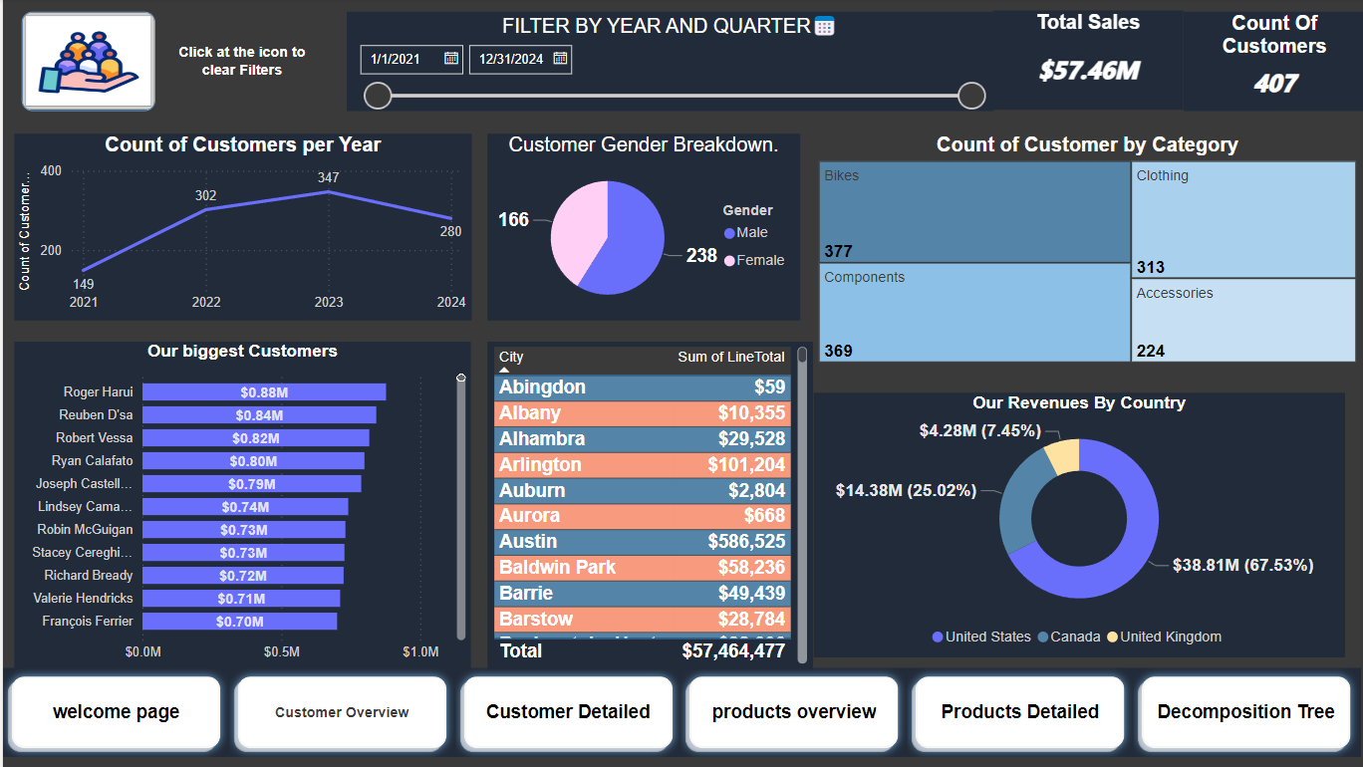
• Power BI Screenshots from each page of the report: Customer overview
This page provides an overview of our customers, including details about our top customers and their locations. It answers questions like: Who are our best customers? How many are there? And which city shows the most interest? Additionally, you can apply filters based on time and country for deeper analysis. Moreover, this page also reveals our total revenue, making it a comprehensive resource for strategic decision-making.

Slide 15
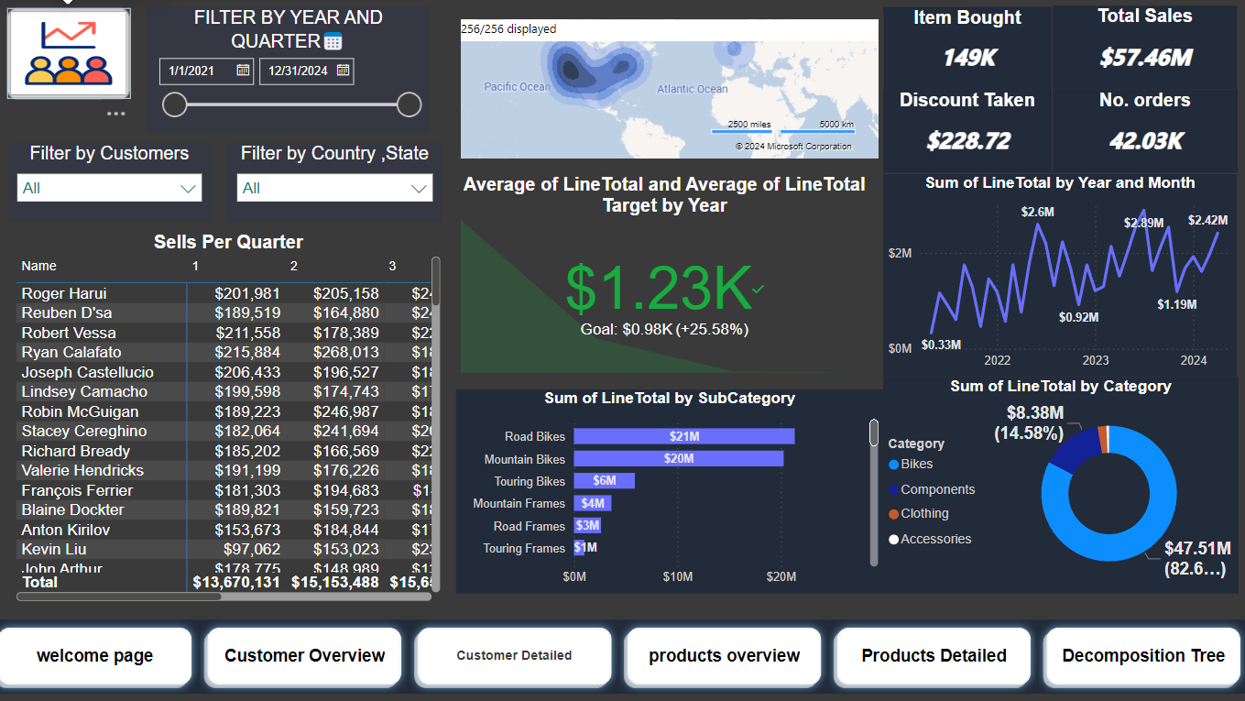
• Power BI Screenshots from each page of the report: Customer Detailed
The Customer Details page provides comprehensive insights about each individual customer. You can select a specific customer or country to explore details such as the number of items they purchased, the total revenue generated, and the specific items they bought. Additionally, it includes yearly sales data, year-over-year changes, and whether the customer’s order exceeds our average. With time and demographic filters, this page offers a wealth of valuable insights.

Slide 16
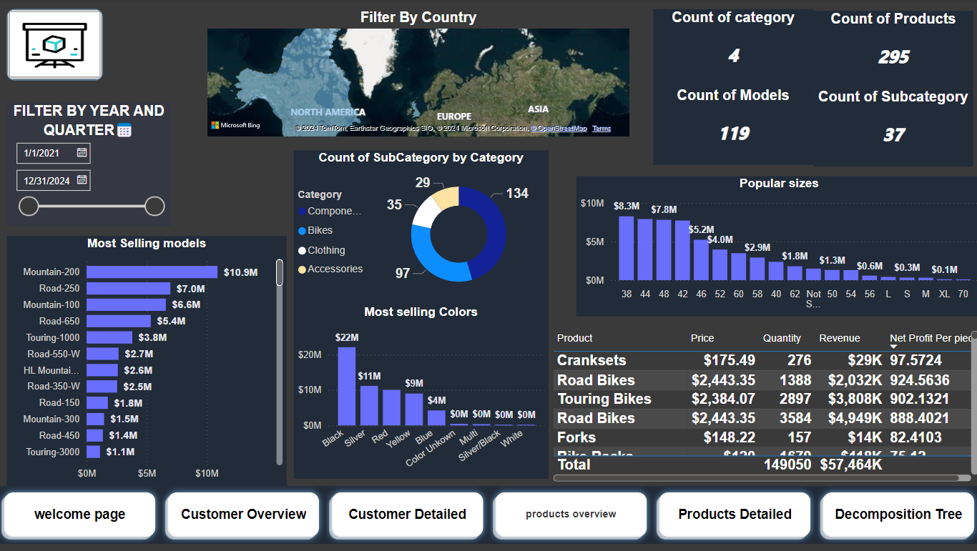
• Power BI Screenshots from each page of the report: Products Overview
If you’re seeking an overview of our products, the Product Overview page is ideal. It reveals which categories sell the most. Additionally, it explores whether factors like color and model size influence sales. Each product has multiple models, and we can analyze the best-performing ones for each country, year, and even quarter using the filters available on the page.
In addition to the other insights, the Product Overview page allows us to delve into the revenue and net profit generated by each product. By analyzing these financial metrics, we can make informed decisions about product performance, pricing strategies, and resource allocation.

Slide 17
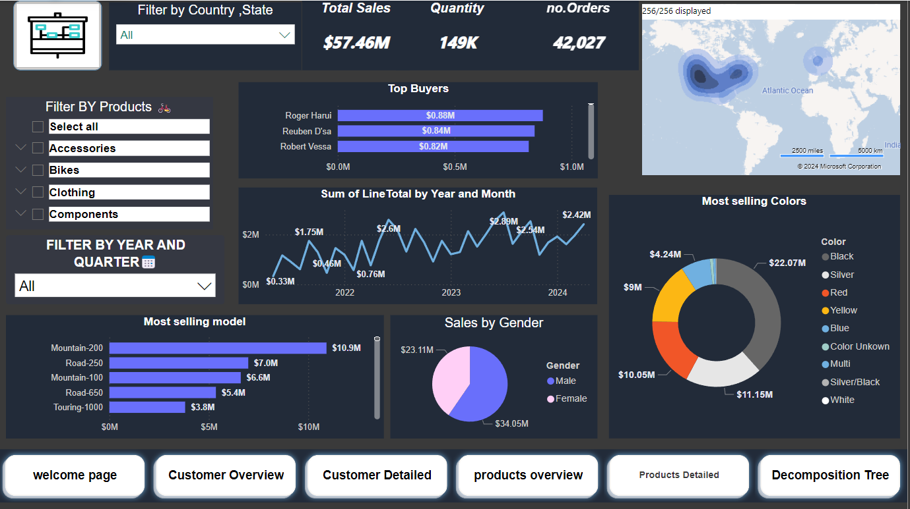
• Power BI Screenshots from each page of the report: Products Detailed
The Products Details page dives deep into everything you need to know about your product line. Powerful filters allow you to explore a wealth of valuable insights by product or category. Discover:
Total Revenue: See how much each product contributes to the bottom line.
Sales Performance: Track trends with metrics like times bought/ordered, year-over-year (YoY) growth, and even monthly sales.
Customer Preferences: Uncover color preferences by gender through dynamic filtering, revealing which colors resonate most with each demographic.
Top Buyers: Identify your biggest fans – see which customer segments purchase specific models the most.
Granular Analysis: Employ time-based and demographic filters to refine your understanding of buying behavior.

Slide 18
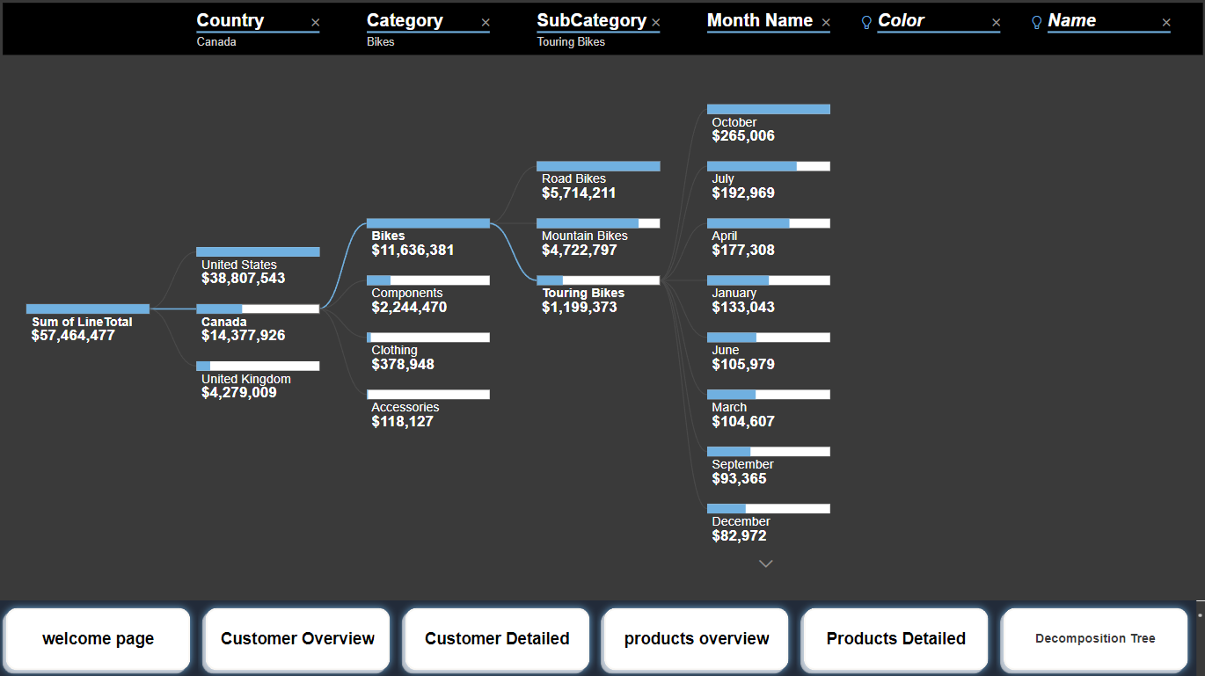
• Power BI Screenshots from each page of the report : Decomposition Tree
What could be better than a fast, accurate summary of our data? The decomposition tree chart excels at describing various aspects, capturing revenue for products or categories across countries and years. By including the best-selling colors and models, this powerful chart provides comprehensive insights.

Slide 19

Thank you
Every remarkable adventure eventually reaches its conclusion. I thoroughly enjoyed every aspect of this journey, from handling OLTP data to deriving valuable insights. The use of powerful tools enabled us to create exceptional analyses for the business.
alhoseinaly86@gmail.com

